Slide 1
IMDB Movies Dataset
By Rachelle Difilippo Professor: Ethan Bard Term: 2021

Slide 2

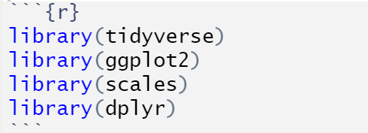
My projects Goal:
To answer any and all questions I have and confirm or deny my predictions. I predict that action and drama will be the most popular genres and it will be because of the actors depending on the point in time which in my test will be around the time of 2005-2010.
To do anything I have to load some stuff from my library in first . . .

Slide 3
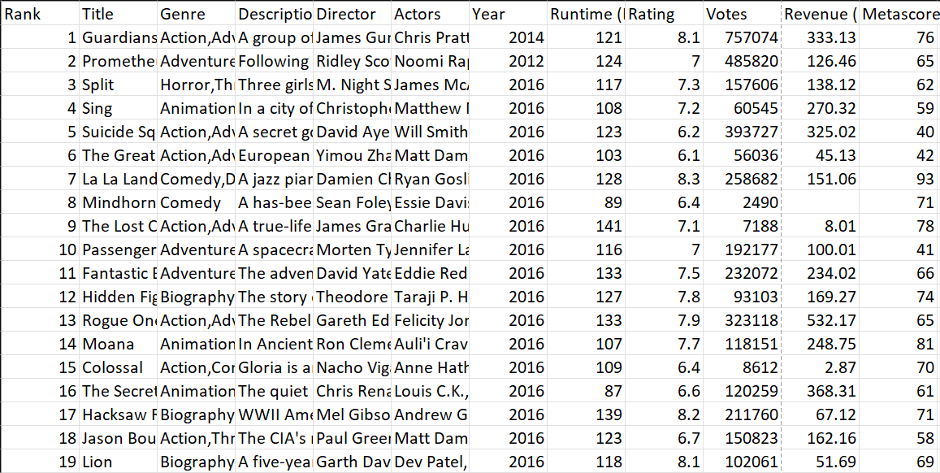
For my project I further Researched the popularity of movies within a set year based off my data set.

Slide 4

The Datasets Main Characteristics
Columns:
Rows:
The Data set provides us with 12 Columns: Title, Genre, Description, Director, Actors, Year, Runtime, Rating, Votes, Revenue, and Metascore.
The Rows in the dataset is the movies rank 1-1000 assuming it's based on the columns Rating, Votes and Revenue.

Slide 5
The start to my research:
At first, I though about starting with a 10-year timespan to work with but when I put it into graph for everything was hard to read on the axis’s and even on the graph, so I narrowed it down. This is important because If I leave it with unreadable data, I might not get the answer I need or was looking for.

Slide 6

Popularity:
In order for someone to determine the popularity of something you can go about a few ways such as voting among a small group, ranking the movies, and Globally voting. This can determine whether a movie is worth making more to or if they should re-use a concept or actor. Another way to determine the popularity of a movie is through the revenue brough up by those movies. If a movie is good people recommend it or post about it on media causing more people to attend the movie which creates more revenue.

Slide 7
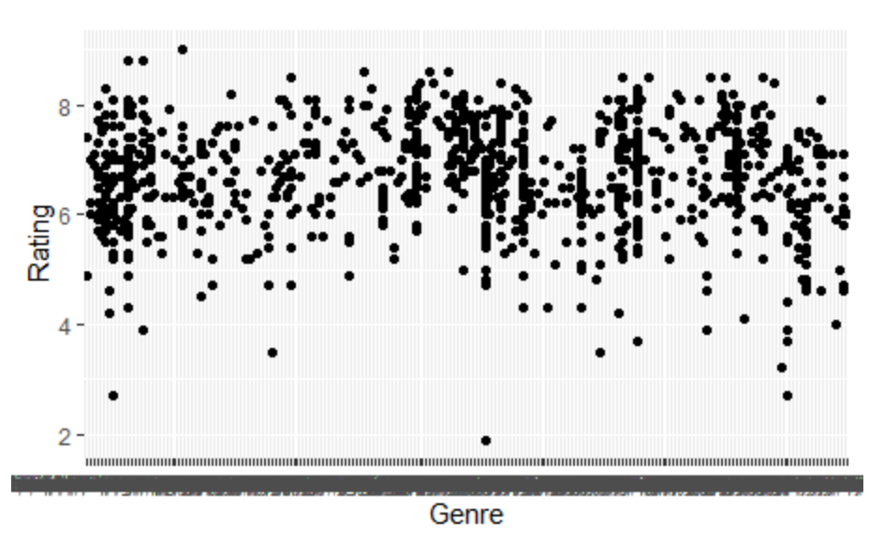
What about the Genre?
The genre has a large impact on a movie because it is the base of a movie. Some very popular genres ive seen based on my data was Action, Drama, and Adventure.

Slide 8
Another aspect that impacts popularity of movies is… Who’s acting in them?
When a new movie is announced, they show clips of it (previews) and if there’s a popular actor/ well liked actor they try to show them in the preview because if someone saw a movie with that actor in it and they really enjoyed it whose to say they wont be good in this movie too.

Slide 9
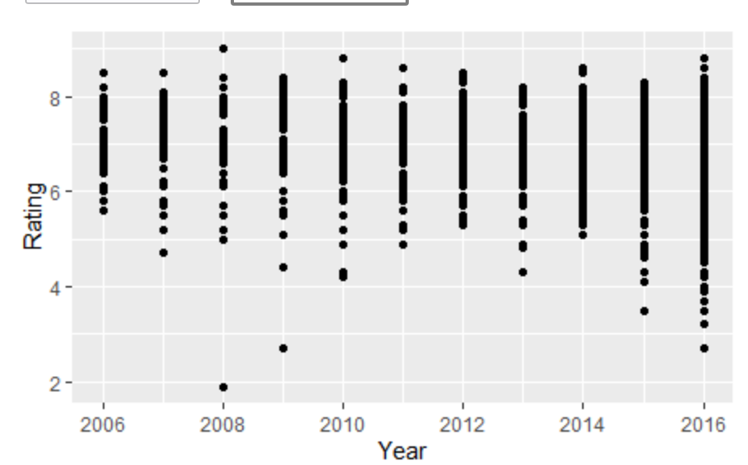
Wait but the last Aspect that impact a movies popularity, what is it?
The Year! Each year a new “Trend” is set, or a new thing is in style. Well, some years maybe a drama is more popular, and I feel this is because of our surroundings and the society we are in where we let other people affect our opinion. We can see in my graph that ratings were at the highest in 2008, 2012, and 2014 and that’s because the main genres were Drama and Action.

Slide 10

Conclusion:
Society has really grown onto the idea of watching other people's drama or watching impossible but incredible action and maybe its because we can't or wont but either way, I think in the next 10 years drama will still be a top Genre. So te next time you go and see a movie think about if you were brought to it by other people's opinions, the ratings, the actors, or because a famous person has.

